Slide 1
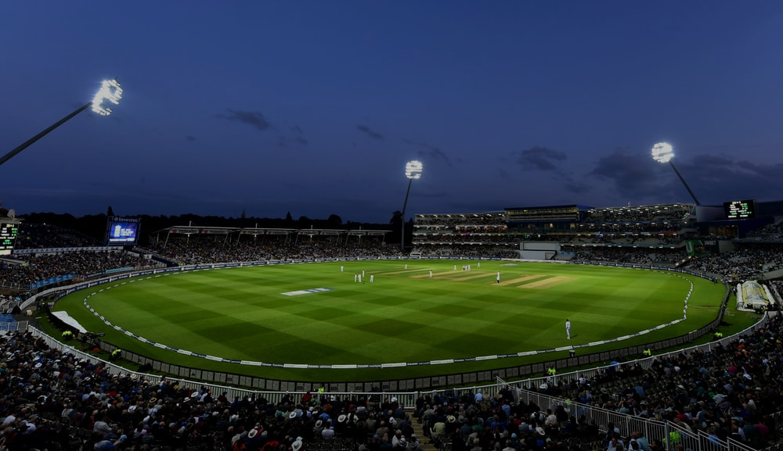
Cricket Data Network Analysis
Group -3
Submitted to : Prof. Amit Nanavati
Umang Patel - AU1940174
Jay Ghetia - AU1940127
Urvish Makwana - AU1940209

Slide 2
Dataset
● There are many dataset available for cricket analysis that we used in this project.
https://cricsheet.org/downloads/#experimental
https://www.kaggle.com/datasets/manasgarg/ipl
https://www.kaggle.com/datasets/patrickb1912/ipl-complete-dataset-20082020?select=IPL+Ball-by-Ball+2008-2020.csv
● Dataset contain information about various different aspects of cricket like ball to ball data, matches win data, one ipl season data and many more.
● We think to use dataset as per the requirement of the question we want to solve.

Slide 3
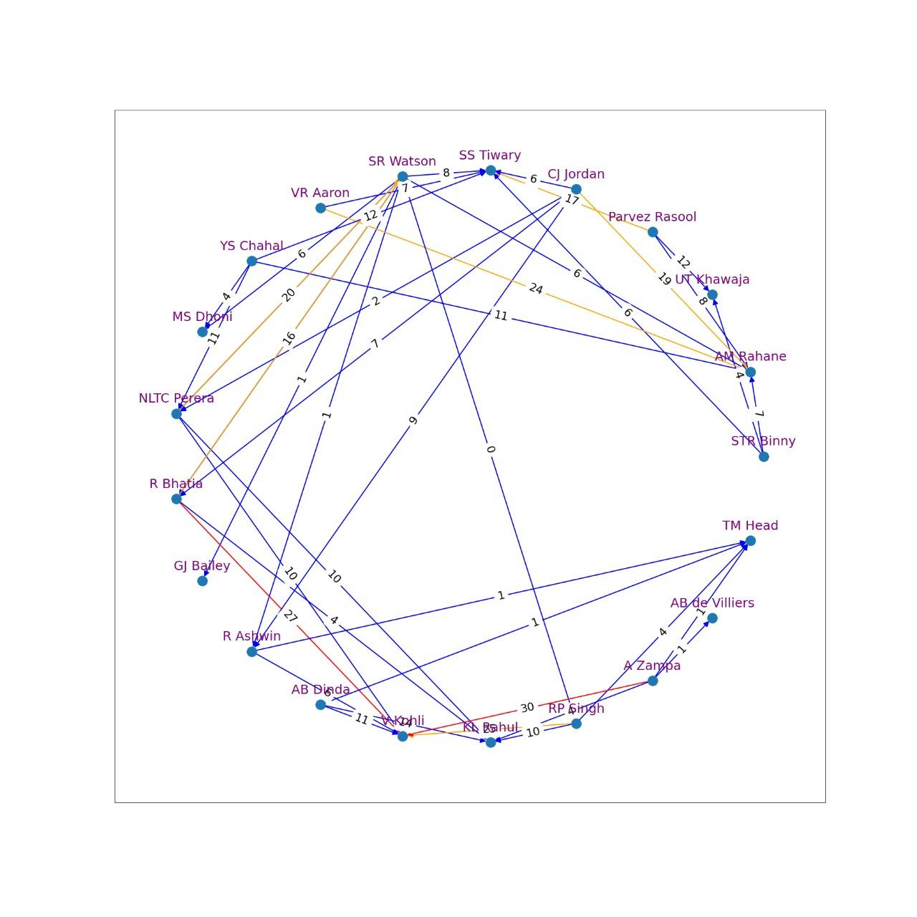
Q - Most valuable batsman of particular season/series or match.
Nodes → Player (batsman and bowler)
Edges → runs scored by batsman
weighted graph
3 Range
Red - above 25 runs
Orange - above 15 runs
Blue - below 15 runs
Virat Kohli has 2 red edges
A Rahane has 2 orange edges

Slide 4
Pagerank
[('V Kohli', 0.13883323546725787),
('AM Rahane', 0.1000159268301116),
('SS Tiwary', 0.08717002549588658),
('KL Rahul', 0.06628412478992703),
('SR Watson', 0.06004648817405449),
('MS Dhoni', 0.045602306675803866),
('UT Khawaja', 0.04482163903363839),
('NLTC Perera', 0.04098370549926644),
('TM Head', 0.03916928571780246),
('R Bhatia', 0.038498932748557854),
('R Ashwin', 0.0375850636490481),
('GJ Bailey', 0.03196991624433954),
('AB de Villiers', 0.03055345679070464),
('STR Binny', 0.02980823661045011),
('Parvez Rasool', 0.02980823661045011),
('CJ Jordan', 0.02980823661045011),
('VR Aaron', 0.02980823661045011),
('YS Chahal', 0.02980823661045011),
('AB Dinda', 0.02980823661045011),
('RP Singh', 0.02980823661045011),
('A Zampa', 0.02980823661045011)]

Slide 5
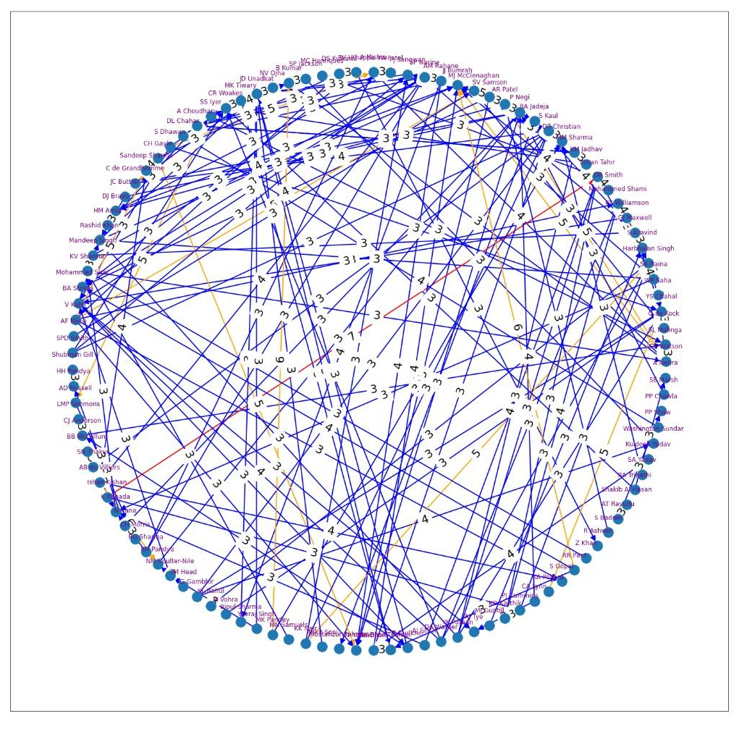
Q - Most valuable bowler of particular season/series or match.(total 250 match )
Nodes → Player (batsman and bowler)
Edges → wickets taken by player
weighted graph
3 Range
Red - 7 or above wickets
Orange - 5 or 6 wickets
Blue - 4 or below wickets
K Rabada has a red edge
If we know 3-4 batsman of opponent team. we can format our team in such a way that for each batsman, we have a dominating bowler.

Slide 6
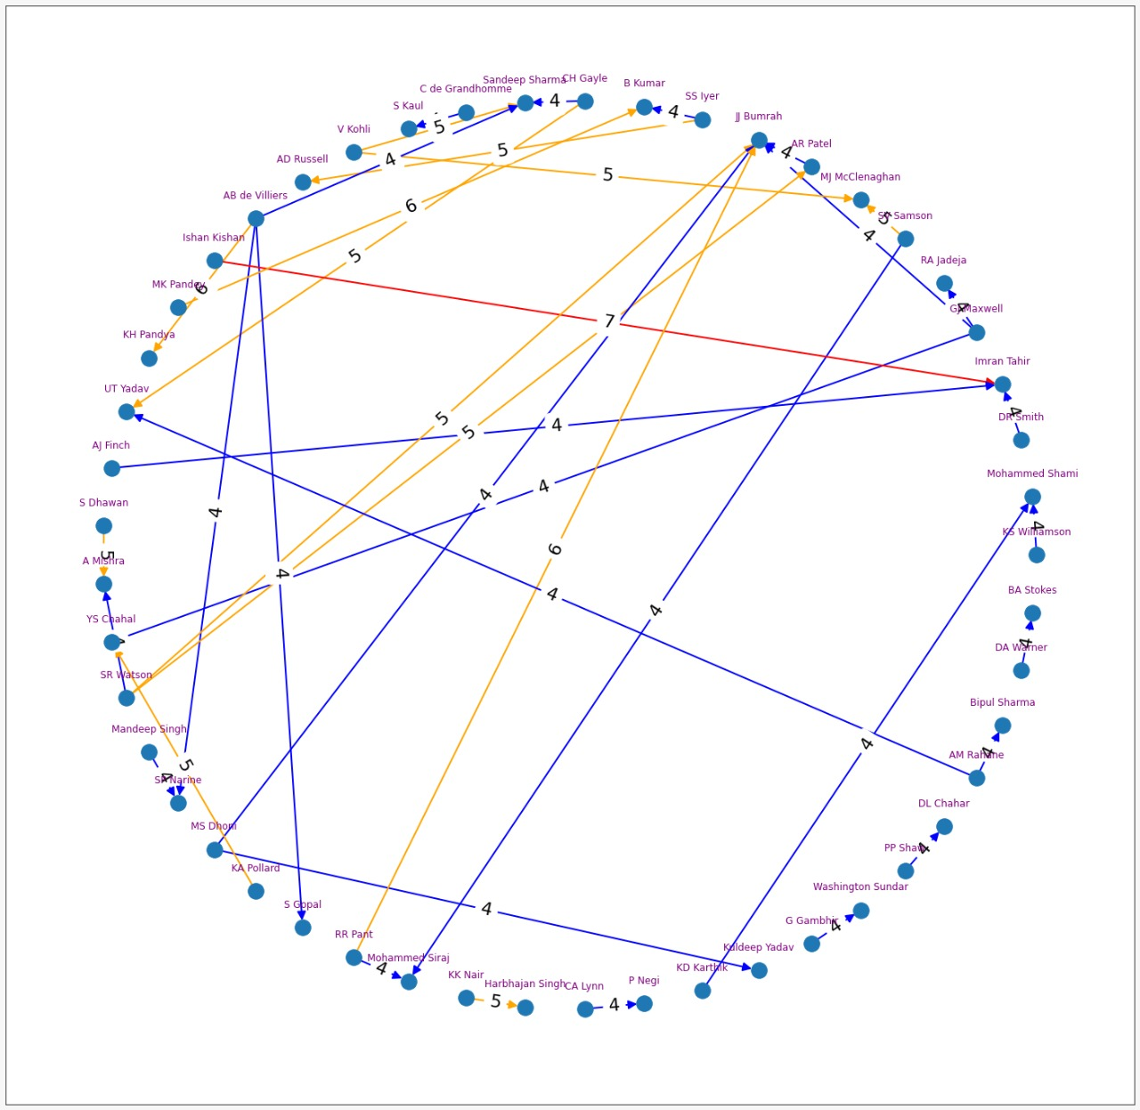

Slide 7
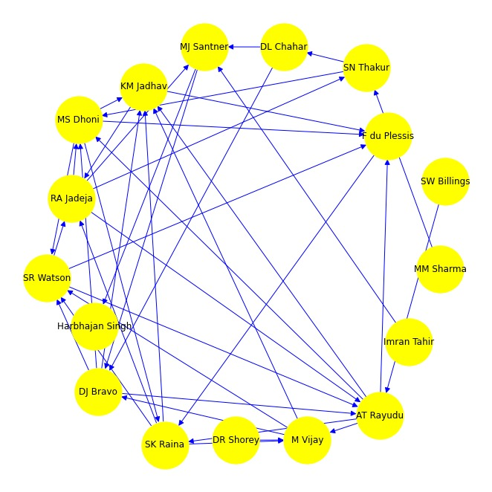
CSK Batting partnership analysis
Nodes → Player (batsman and bowler)
Edges → Runs scored by both batsman (Partnership)
Directed graph
Here Direction (arrow) represent that contribution of that batsman is more.
Most In degree - KM Jadhav
Most Out degree - Ambati Rayudu
Most Total Degree - Ambati Rayudu

Slide 8
Total Degree
In Degree
Out Degree
[('AT Rayudu', 9),
('MS Dhoni', 8),
('SR Watson', 7),
('SK Raina', 7),
('KM Jadhav', 7),
('RA Jadeja', 7),
('DJ Bravo', 7),
('M Vijay', 6),
('F du Plessis', 5),
('MJ Santner', 5),
('SN Thakur', 4),
('DL Chahar', 3),
('MM Sharma', 1),
('SW Billings', 1),
('DR Shorey', 1),
('Harbhajan Singh', 1),
('Imran Tahir', 1)]
[('KM Jadhav', 5),
('SR Watson', 4),
('AT Rayudu', 4),
('MS Dhoni', 4),
('F du Plessis', 4),
('SK Raina', 3),
('RA Jadeja', 3),
('DJ Bravo', 3),
('MJ Santner', 3),
('M Vijay', 3),
('SN Thakur', 2),
('DL Chahar', 1),
('Harbhajan Singh', 1),
('MM Sharma', 0),
('SW Billings', 0),
('DR Shorey', 0),
('Imran Tahir', 0)]
[('AT Rayudu', 5),
('SK Raina', 4),
('RA Jadeja', 4),
('MS Dhoni', 4),
('DJ Bravo', 4),
('SR Watson', 3),
('M Vijay', 3),
('KM Jadhav', 2),
('DL Chahar', 2),
('SN Thakur', 2),
('MJ Santner', 2),
('MM Sharma', 1),
('F du Plessis', 1),
('SW Billings', 1),
('DR Shorey', 1),
('Imran Tahir', 1),
('Harbhajan Singh', 0)]

Slide 9
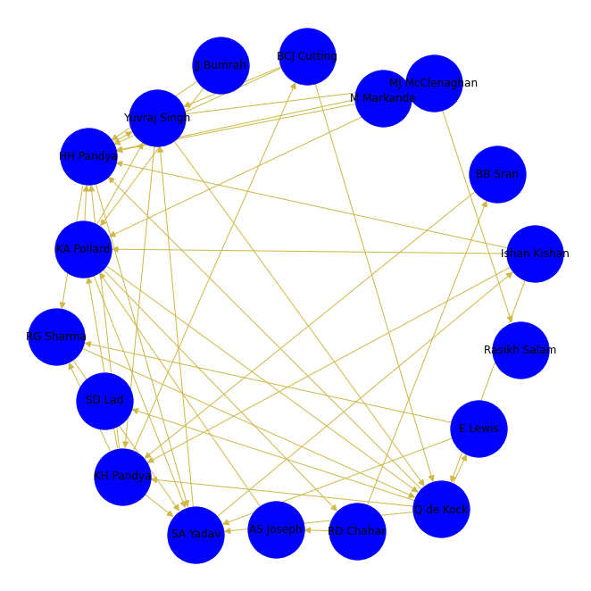
MI Batting partnership analysis
Nodes → Player (batsman and bowler)
Edges → Runs scored by both batsman (Partnership)
Directed graph
Here Direction (arrow) represent that contribution of that batsman is more.
Most In degree - Hardik Pandya
Most Out degree - Q de kock
Most Total Degree - Hardik Pandya

Slide 10
Total Degree
In Degree
Out Degree
[('HH Pandya', 11),
('Q de Kock', 10),
('KA Pollard', 10),
('KH Pandya', 9),
('SA Yadav', 8),
('Yuvraj Singh', 7),
('RG Sharma', 5),
('MJ McClenaghan', 5),
('Ishan Kishan', 5),
('BCJ Cutting', 4),
('RD Chahar', 3),
('E Lewis', 3),
('M Markande', 2),
('JJ Bumrah', 2),
('AS Joseph', 2),
('BB Sran', 2),
('Rasikh Salam', 1),
('SD Lad', 1)]
[('HH Pandya', 8),
('SA Yadav', 6),
('Q de Kock', 5),
('KA Pollard', 5),
('Yuvraj Singh', 4),
('KH Pandya', 4),
('RG Sharma', 3),
('MJ McClenaghan', 2),
('BCJ Cutting', 1),
('Rasikh Salam', 1),
('Ishan Kishan', 1),
('RD Chahar', 1),
('AS Joseph', 1),
('SD Lad', 1),
('E Lewis', 1),
('BB Sran', 1),
('M Markande', 0),
('JJ Bumrah', 0)]
[('Q de Kock', 5),
('KA Pollard', 5),
('KH Pandya', 5),
('Ishan Kishan', 4),
('Yuvraj Singh', 3),
('HH Pandya', 3),
('BCJ Cutting', 3),
('MJ McClenaghan', 3),
('RG Sharma', 2),
('SA Yadav', 2),
('M Markande', 2),
('JJ Bumrah', 2),
('RD Chahar', 2),
('E Lewis', 2),
('AS Joseph', 1),
('BB Sran', 1),
('Rasikh Salam', 0),
('SD Lad', 0)]

Slide 11
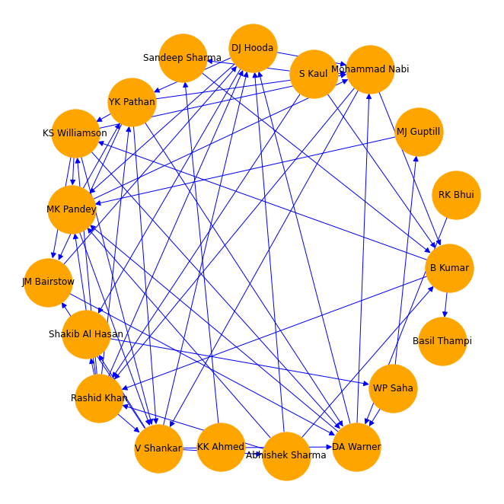
SRH Batting partnership analysis
Nodes → Player (batsman and bowler)
Edges → Runs scored by both batsman (Partnership)
Directed graph
Here Direction (arrow) represent that contribution of that batsman is more.
Most In degree - DA Warner
Most Out degree - Rashid Khan
Most Total Degree - Vijay Sankar

Slide 12
Total Degree
In Degree
Out Degree
[('V Shankar', 10),
('Rashid Khan', 10),
('DA Warner', 9),
('MK Pandey', 9),
('DJ Hooda', 9),
('YK Pathan', 8),
('KS Williamson', 8),
('Mohammad Nabi', 8),
('B Kumar', 7),
('JM Bairstow', 5),
('Abhishek Sharma', 5),
('Shakib Al Hasan', 4),
('S Kaul', 3),
('Sandeep Sharma', 3),
('WP Saha', 3),
('MJ Guptill', 2),
('RK Bhui', 1),
('KK Ahmed', 1),
('Basil Thampi', 1)]
[('DA Warner', 6),
('MK Pandey', 6),
('V Shankar', 5),
('DJ Hooda', 5),
('Mohammad Nabi', 5),
('Rashid Khan', 4),
('B Kumar', 4),
('JM Bairstow', 3),
('YK Pathan', 3),
('KS Williamson', 3),
('Shakib Al Hasan', 3),
('Sandeep Sharma', 2),
('Abhishek Sharma', 1),
('WP Saha', 1),
('MJ Guptill', 1),
('Basil Thampi', 1),
('S Kaul', 0),
('RK Bhui', 0),
('KK Ahmed', 0)]
[('Rashid Khan', 6),
('V Shankar', 5),
('YK Pathan', 5),
('KS Williamson', 5),
('DJ Hooda', 4),
('Abhishek Sharma', 4),
('DA Warner', 3),
('MK Pandey', 3),
('Mohammad Nabi', 3),
('B Kumar', 3),
('S Kaul', 3),
('JM Bairstow', 2),
('WP Saha', 2),
('Sandeep Sharma', 1),
('RK Bhui', 1),
('KK Ahmed', 1),
('Shakib Al Hasan', 1),
('MJ Guptill', 1),
('Basil Thampi', 0)]

Slide 13
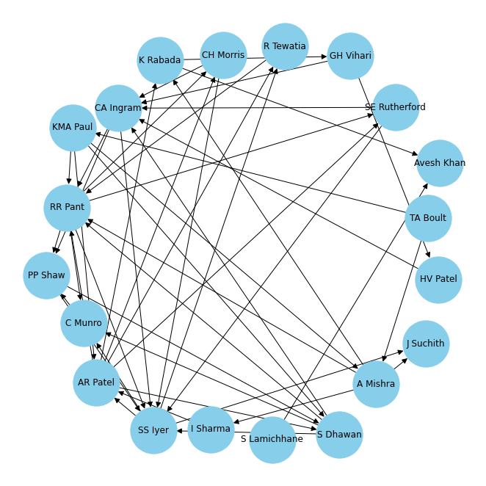
DC Batting partnership analysis
Nodes → Player (batsman and bowler)
Edges → Runs scored by both batsman (Partnership)
Directed graph
Here Direction (arrow) represent that contribution of that batsman is more.
Most In degree - SS Iyer
Most Out degree - AR Patel
Most Total Degree - RR Pant

Slide 14
Total Degree
In Degree
Out Degree
[('RR Pant', 11),
('SS Iyer', 10),
('AR Patel', 9),
('CA Ingram', 8),
('S Dhawan', 7),
('A Mishra', 6),
('PP Shaw', 5),
('KMA Paul', 5),
('CH Morris', 4),
('K Rabada', 4),
('C Munro', 4),
('SE Rutherford', 4),
('R Tewatia', 3),
('GH Vihari', 3),
('HV Patel', 2),
('Avesh Khan', 2),
('I Sharma', 2),
('J Suchith', 2),
('TA Boult', 2),
('S Lamichhane', 1)]
[('SS Iyer', 6),
('RR Pant', 6),
('CA Ingram', 5),
('PP Shaw', 3),
('S Dhawan', 3),
('AR Patel', 3),
('C Munro', 3),
('R Tewatia', 2),
('CH Morris', 2),
('K Rabada', 2),
('Avesh Khan', 2),
('A Mishra', 2),
('SE Rutherford', 2),
('J Suchith', 2),
('KMA Paul', 1),
('GH Vihari', 1),
('HV Patel', 1),
('I Sharma', 1),
('S Lamichhane', 0),
('TA Boult', 0)]
[('AR Patel', 6),
('RR Pant', 5),
('S Dhawan', 4),
('SS Iyer', 4),
('KMA Paul', 4),
('A Mishra', 4),
('CA Ingram', 3),
('PP Shaw', 2),
('GH Vihari', 2),
('CH Morris', 2),
('K Rabada', 2),
('SE Rutherford', 2),
('TA Boult', 2),
('R Tewatia', 1),
('HV Patel', 1),
('S Lamichhane', 1),
('I Sharma', 1),
('C Munro', 1),
('Avesh Khan', 0),
('J Suchith', 0)]

Slide 15
Analysis of all 4 graph together
From the data we can say that CSK and SRH does not relay on a single batsman. Everyone in the team is equally contributing in the team.
But on the other hand in MI team, “HH Pandya” is dominating in indegree, out degree and total degree partnership. So, We can say that to not pick HH Pandya might be the reason behind the 8 continuous loss of MI in this season(2022)
Surprisingly In SRH team rashid khan has highest out degree and 2nd highest total degree even if he is a bowler. This shows his potential to build partnership with other batsman

Slide 16
Game Theory in Cricket
 |  | Batsman
 |  | Pull Shot | Cut Shot | Drive | Punch
 | Back of length | (0.09,1.31) | (0.01,1) | (0,1.67) | (0.04,0.81)
 | Googly | (0.08, 1) | (0.15 ,0.73) | (0.11,0.72) | (0,0.63)
 | Yorker | (0,0) | (0,2.3) | (0.04, 1.48) | (0,0)
 | Slower ball | (0.12, 1.22) | (0.19, 0.81) | (0.11,0.94) | (0,1.07)
Bowler
IPL - 2019 Data

Slide 17
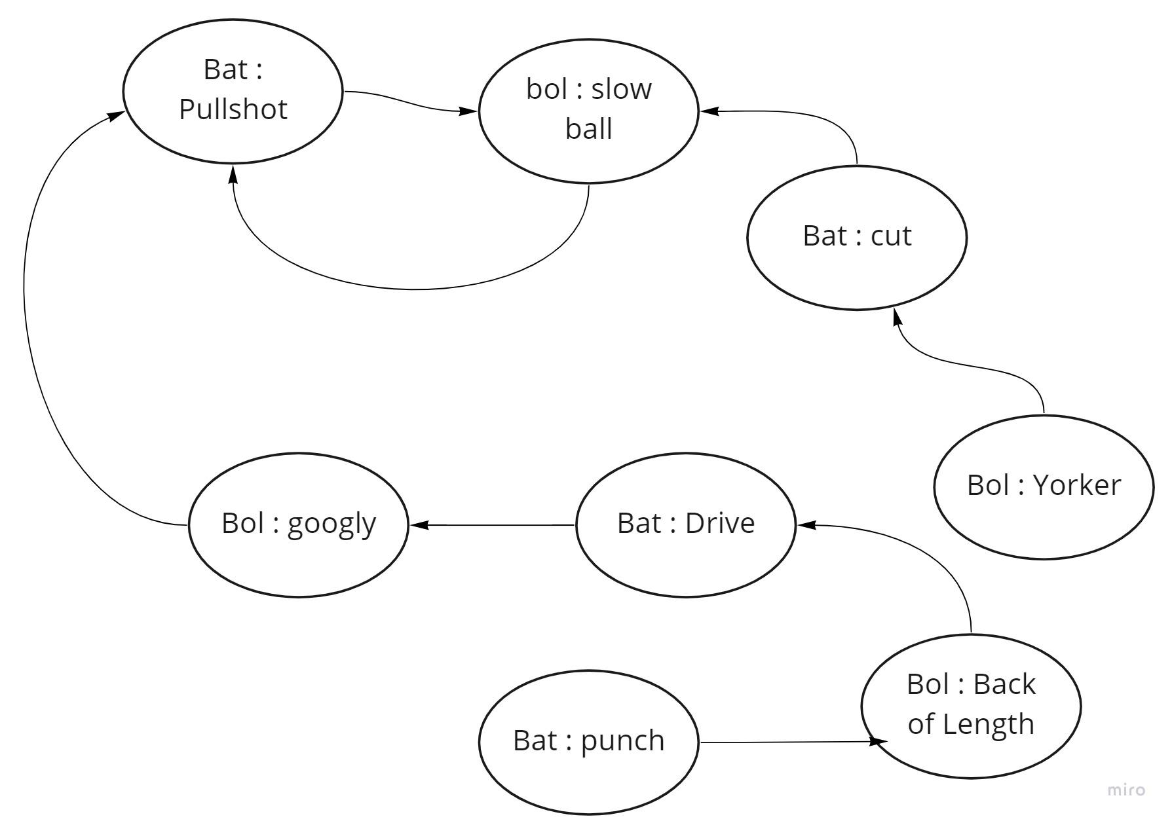
Best response graph

Slide 18
Game Theory analysis
Q- What is the best response for the batsman when bowler ball a Back of length?
→ Drive Shot
Q- What is the best response for the batsman when bowler ball a Googly?
→ Pull Shot
Q- What is the best response for the batsman when bowler ball a Yorker?
→ Cut Shot
Q- What is the best response for the batsman when bowler ball a Slower ball?
→ Pull Shot

Slide 19

Game Theory analysis
Q- What is the best response for the Bowler when Batsman has Strength in playing Pull Shot?
→ Slower ball
Q- What is the best response for the Bowler when Batsman has Strength in playing Cut Shot?
→ Slower ball
Q- What is the best response for the batsman when Batsman has Strength in playing Drive Shot?
→ Slower ball or Googly
Q- What is the best response for the batsman when Batsman has Strength in playing Punch Shot?
→ back of a Length ball
Amazing Insights:
As we can see, out of the four best response, 3 has a slower ball, so we can say that to maximize the bowler’s payoff, they should ball a slower ball regardless of what strength a batsman have.

Slide 20
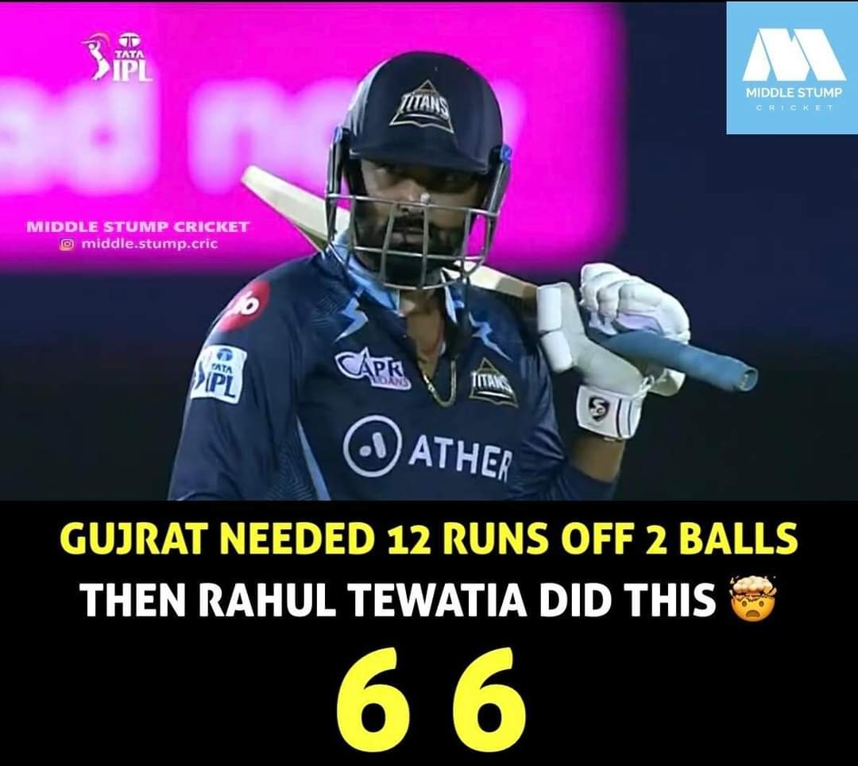
Game Theory analysis
There is no Nash Equilibrium.
There is no strictly dominant strategy against all ball or shot in cricket, but there can be a different and individual dominant strategy for the particular ball or shot.
Cricket is unpredictable

Slide 21
Literature Survey
Akbar Hussain1, Yan Qiang. (n.d.). Region-wise ranking for one-Day international . Retrieved from https://pdfs.semanticscholar.org/6784/5be45325298bae20b2ec3c04ba5a53fcb169.pdf - Team rank (Pagerank algorithm)
Dr. R. Ramesh. Game theory-nash equilibrium and its applications, from http://www.journalstd.com/gallery/5-oct2019special.pdf - Game Thoery in Cricket
Network Analysis Python for IPL 2019. Analytics Vidhya. (2020, June 14). Retrieved from https://www.analyticsvidhya.com/blog/2020/02/network-analysis-ipl-data/

Slide 22
Thank You.

